Slide 1

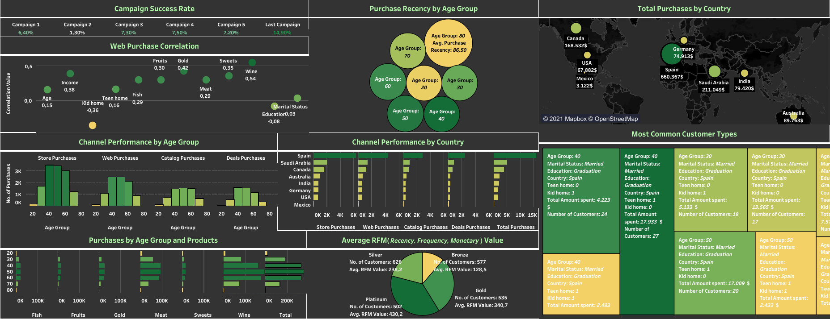
Maven Marketing Challenge
by Selmir Kalender
Data Quality Issues
Accuracy issues - ‘Year_Birth’ is inaccurate (customer age is 121, 122, and 128), missing columns ‘Age’ and ‘Age_Groups’ for better readability, the column ’ Income’ has 2 placeholders, it’s changed to ‘Income’, misspelled Value in the column ‘Education’
Completenes - The column ‘Income’ is missing data in 24 cells which were replaced with the average income based on education.
Consistency - The column ‘Marital_Status’ has inconsistent specifications (Widow – changed to Widowed, Absurd - changed to Unknown, Together - changed to Partnered, Alone – changed to Single, YOLO – changed to Unknown)
Orderliness - Incorrect formats in several columns (Instead of currency, the column ‘Income’ has the text format etc.)
Uniqueness - The Customer IDs 492 and 11133 represent the same person
Recommendations
Since Mexico is showing a significant underperformance in all categories, it is recommended to either drop this location and focus on the other countries, or advertise more through the available channels and offer discount points/rewards etc. to attract more customers
In order to increase the conversion rates, you should create a point reward system for the Platinum Customers, who bring the highest value to your business, as well as focus more on visually appealing product placements on the provided channels.
Make use of social media platforms, to reach more customers who belong to the age groups 20 and 30

